Slide 1
Module 2.2 Monitoring activity data for forests remaining forests (including forest degradation)
Module developers:
Carlos Souza Jr., Imazon
Sandra Brown, Winrock International
Frédéric Achard, European Commission - Joint Research Centre
Country examples:
Peru
Cameroon
Bolivia
Region of Pulcallpa in Peru
Asner et al., 2009. Application of CLASlite for mapping deforestation and forest degradation.
V1, May 2015
Creative Commons License

Slide 2
Introduction to Country Examples
The examples of this module illustrate how forest degradation has been mapped in three countries: Peru, Cameroon, and Bolivia.
Up to now, there has been no operational forest monitoring of forest degradation besides Brazil’s official system (DEGRAD from INPE) and an independent system from Imazon.
The applications covered in this tutorial are based on scientific studies; these results hold promise to scaling up operational forest-monitoring programs of forest degradation.
The examples focus on Landsat-like sensors.
Notes:
Overall Sources:
Asner et al. 2009;
Souza, Roberts, and Cochrane 2005.

Slide 3
1. Peru: Monitoring forest degradation using CLASlite
CLASlite is an automated system developed by Carnegie Institute for Science for:
calibration, preprocessing, atmospheric correction, cloud masking, Monte Carlo Spectral Mixture Analysis, and expert classification
CLASlite is capable of detecting deforestation and forest degradation, and was initially applied in Brazil and quickly expanded across Latin America, Africa, Asia. and other regions.
In 2009, the Minister of Environment of Peru (MINAM) through DGOT division, started a capacity-building program on remote sensing to support their zoning and planning program.
CLASlite was used extensively to monitor deforestation and forest degradation.
Peruvian forest change statistics became openly accessible to the general public through this program.
Notes:
Sources:
Directorate General of Land Management (DGOT), Ministry of the Environment, Peru, reports and maps, http://geoservidor.minam.gob.pe/geoservidor/deforestacion.aspx;
Media coverage by Mongabay.com (Butler 2013).

Slide 4
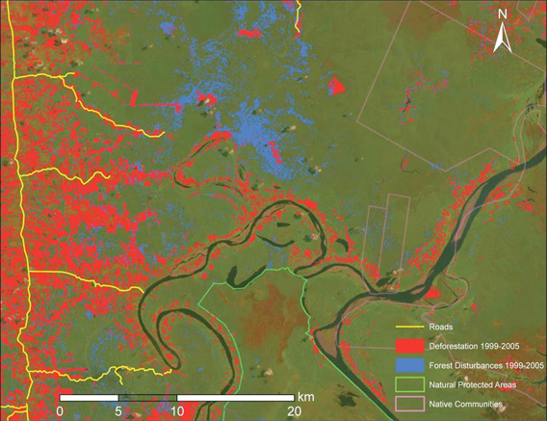
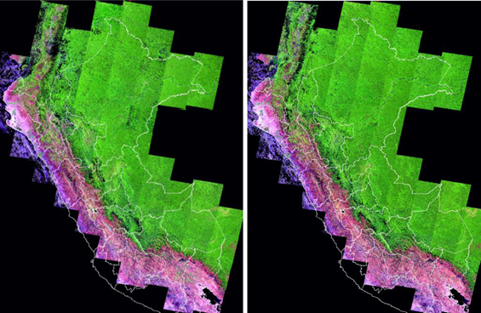
Forest degradation results using CLASlite
Deforestation in Peru
CLASlite map generated from satellite imagery in the Peruvian Amazon
2009–2010 2010–2011
While deforestation statistics had been published through MINAM DGOT for Peru, forest degradation results are still under evaluation
Source: http://claslite.carnegiescience.edu/en/success-stories/peru-national-monitoring.html
Notes:
Source:
Ministerio del Ambiente de Perú 2011. See pages 122–123, “La pérdida de los bosques en el Perú.”

Slide 5
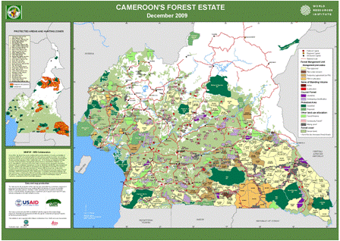
2. Cameroon: Monitoring forest degradation using NDFI
Located in the Congo Basin, Cameroon holds a large area of tropical evergreen forests.
Forest degradation associated with fires and selective logging are one of the major threats to Cameroon’s forests.
Most of the logging activities in Cameroon happens in concessions.
Forest degradation associated with selective logging has been successfully detected and mapped in the southeast region of the Republic of Cameroon using NDFI (Normalized Differencing Fraction Index).
Source: WRI, 2009. Cameroon Forest Land Allocation
Notes:
Sources:
Montellano and Armijo 2011;
REDD Desk, n.d.

Slide 6
Forest degradation test site
Orthorectified Landsat 7 ETM+ (path/row: 184/058) for 2002, 2004, 2005, 2006 2007, 2008 and 2009 were used.
The image processing procedures included:
Atmospheric correction
Spectral Mixture Analysis
Calculation of NDFI
Image classification
→ See lecture materials for more detail on these methods
Source: Montellano and Armijo 2011.

Slide 7
Detection of forest degradation using NDFI image
NDFI image
Degraded forest
Logging area
Canopy damage in a logging area
Source: Montellano and Armijo 2011, fig. 4a and fig. 4b.
Notes:
7

Slide 8
Cameroon: Forest degradation example
Log landings (in red) and canopy damage (in white)
GIS ancillary layer: roads (in black)
Source: Montellano and Armijo 2011, fig. 6c and fig. 6d.
Notes:
Forest degradation associated with road log landings (i.e., decks) were accurately detected using NDFI.
Canopy damage areas associated with tree falls were not observed in the NDFI images. This may be due to the low intensity of logging harvesting.
This type of approach can be useful for monitoring forest concessions and assessing whether logging is being carried on via reduced impact practices (i.e., very low canopy damage areas and low density of roads and log landings).
8

Slide 9
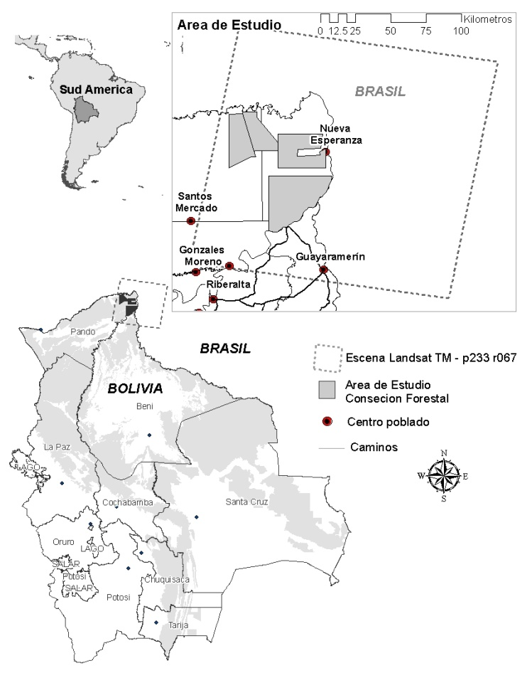
3. Bolivia: Monitoring forest degradation using a combination of SMA fractions and NDFI
Forest degradation associated with selective logging and forest fires were mapped in Bolivia using a combination of SMA fractions and NDFI.
Landsat images from 2003 to 2009 were used.
The study site is located at Mabet Forest Concession located at the Pando district, Bolivia, covering almost 50 thousand hectares.
The image processing protocol followed the methodology proposed by Souza et al. (2013).
Study site in Bolivia at the Pando district
Notes:
SMA = Spectral Mixture Analysis
Image crecit: Montellano
Source:
Souza Jr. et al. 2013. “Ten-Year Landsat Classification of Deforestation and Forest Degradation in the Brazilian Amazon.” Remote Sensing 5 (11): 5493v–5513. doi: 10.3390/rs5115493.

Slide 10
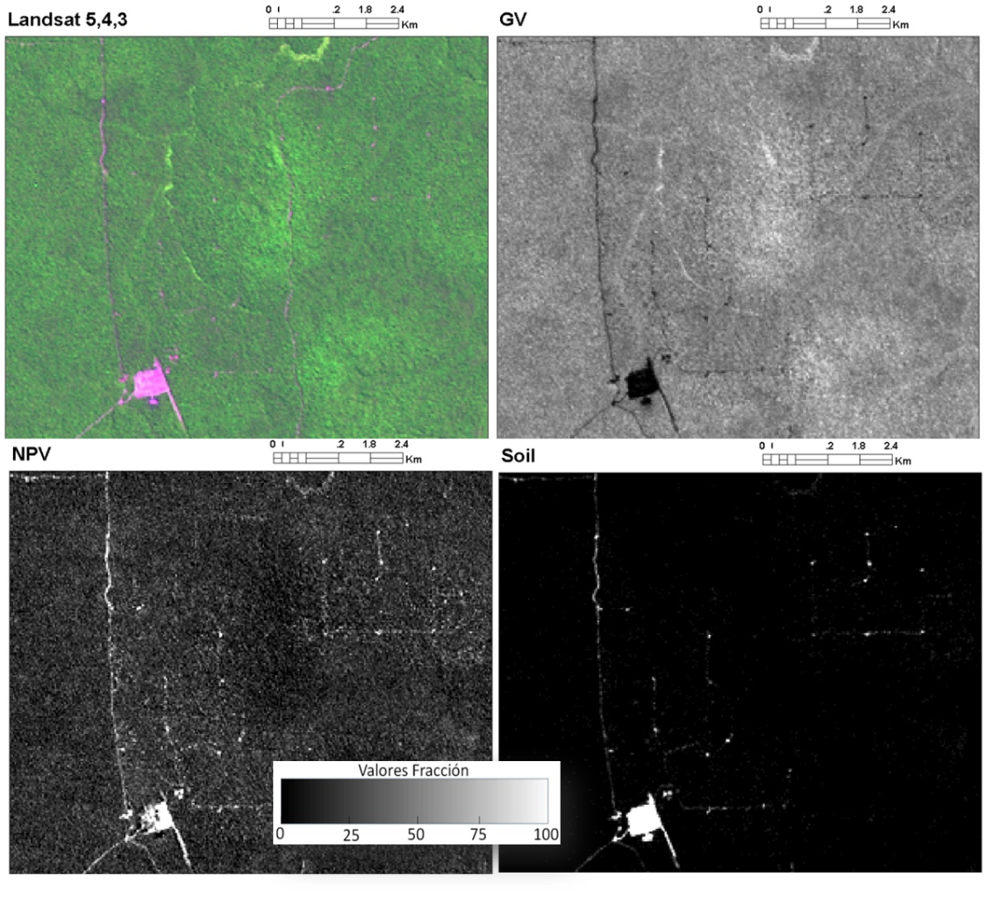
SMA fractions
Landsat RGB (5,4,3) showing no evidence of selective logging activity.
SMA fractions revealed better the location of roads and log landings (soil) and associated canopy damage (NPV fraction).
Landsat 5,4,3
Green Vegetation
NPV
Soil
Subset of the Landsat image acquired in 2010
Notes:
Credit:
Montellano.
Note:
NPV = nonphotosynthetic vegetation.
10

Slide 11
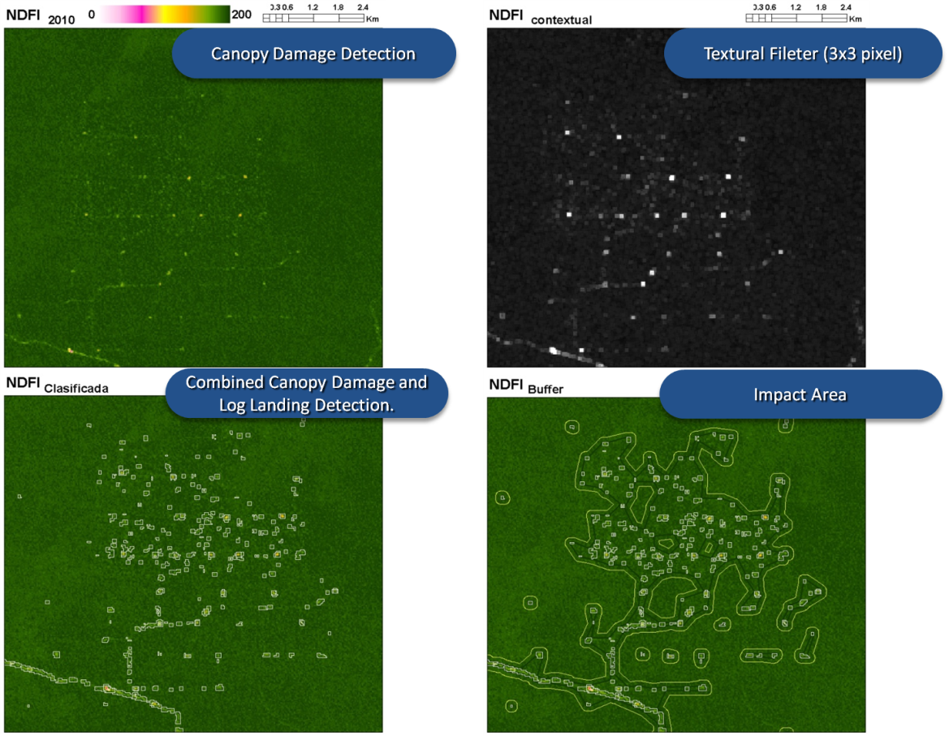
Hybrid approach to estimate canopy damage
A hybrid approach was used, combining the detection of
logging infrasctruture (i.e., roads and log landings),
textural analysis,
buffer spatial analysis (radius = 120 meters), and
polygon region aggregation (500 meters)
to estimate areas of forest canopy damage
Combining logging landings detection and spatial analysis to estimate canopy damage areas
Notes:
Credit:
Montellano.
11

Slide 12
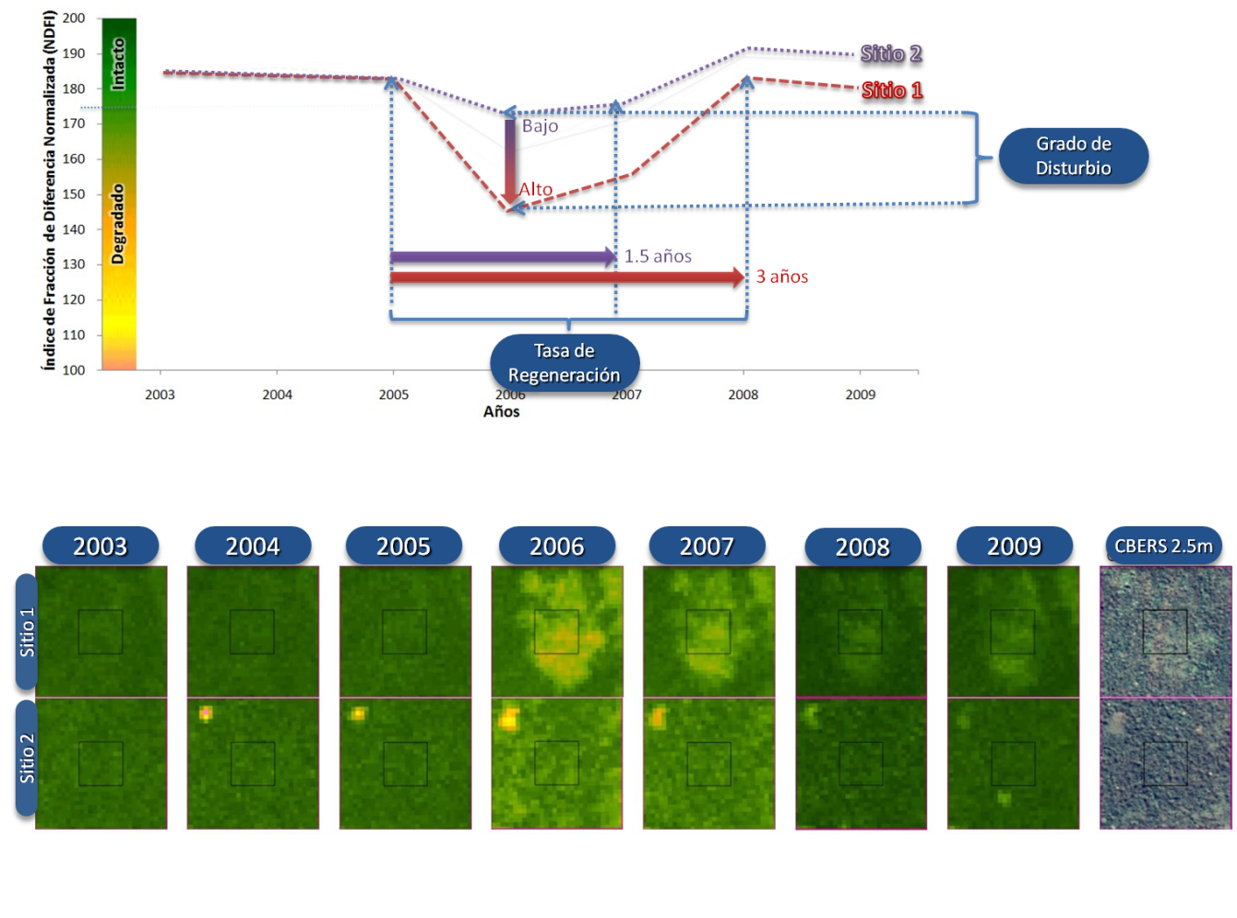
Temporal analysis of NDFI images
Temporal analysis of NDFI images showing detection of forest degradation and forest canopy regeneration
Detection of logging impacts lasts no more than one year
Notes:
Credit:
Montellano.
12

Slide 13
Conclusions
SMA and NDFI were useful to detect logging infrastructure in the forest concession areas.
Annual time-series of Landsat imagery is necessary to assess whether concession sites are being harvested or not.
Introducing textural and spatial analysis (buffer and spatial aggregation) allows to estimate forest canopy damage areas associated with selective logging.
Notes:
13

Slide 14
Recommended modules as follow-up
Module 2.3 for methods to assess emission factors in order to calculate changes in forest carbon stocks
Modules 3.1 to 3.3 to learn more about REDD+ assessment and reporting

Slide 15
References
Asner, Gregory P., David E. Knapp, Aravindh Balaji, and Guayana Páez-Acosta. 2009. Automated mapping of tropical deforestation and forest degradation: CLASlite. Journal of Applied Remote Sensing 3: 033543.
Butler, Rhett. 2013. “Peru Opens Deforestation Data to the Public, Shows Drop in Amazon Forest Clearing.” Mongabay.com, June 13. http://news.mongabay.com/2013/0613-peru-deforestation-tracking-system.html
Ministerio del Ambiente de Perú. 2011. Programa Nacional de Conservación de Bosques para la Mitigación del Cambio Climático: Ministerio de Agricultura de Perú. Lima: Dirección General Forestal y Fauna Silvestre.
Montellano, A. R., and E. Armijo. 2011. “Detecting Forest Degradation Patterns in Southeast Cameroon.” Paper presented at Instituto Nacional de Pesquisas Espaciais, “Anais XV Simpósio Brasileiro de Sensoriamento Remoto,” Curitiba, PR, Brasil, 30 de abril a 05 de maio. http://www.dsr.inpe.br/sbsr2011/files/p0558.pdf
REDD Desk, “REDD in Cameroon,” n.d., http://theredddesk.org/countries/Cameroon.

Slide 16
Souza Jr., C. M., D. Roberts, and M. A. Cochrane, M. A. 2005. “Combining Spectral and Spatial Information to Map Canopy Damages from Selective Logging and Forest Fires.” Remote Sensing of Environment 98: 329-343.
Souza, C.M. Jr., Siqueira, J., Sales, M.H., Fonseca, A.V., Ribeiro, J.G., Numata, I., Cochrane, M.A., Barber, C.P., Roberts, D.A. and Barlow, J., 2013. “Ten-Year Landsat Classification of Deforestation and Forest Degradation in the Brazilian Amazon.” Remote Sensing 5 (11): 5493–5513. doi: 10.3390/rs5115493.
WRI, 2009. Cameroon Forest Land Allocation. http://www.wri.org/resources/maps/cameroon-forest-land-allocation-2009

